Slide 1


TIC TAC TOE GAME CIRCUIT USING LOGISIM
Team Members Details:-
Ojas Kumar Kashyap (22BCE0721)
Sushil Kumar Shourya (22BCE0775)

Slide 2
Outline:
Objectives
Introduction
Components used
Circuit design
Move counter circuit
Winning combination detector circuit
Final circuit
Result in different game scenarios
Applications
Conclusion

Slide 3
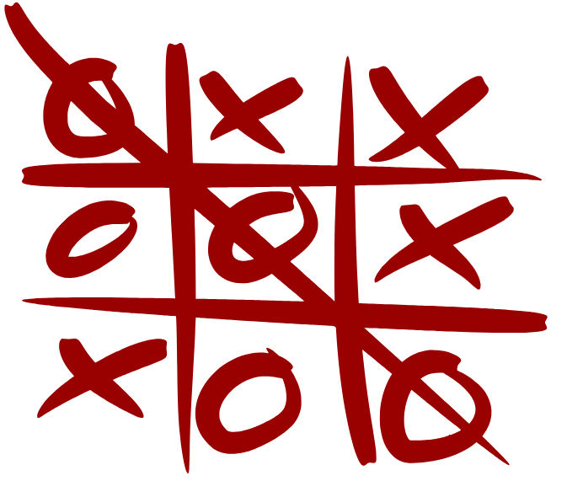
Objective:
To design and simulate a Tic Tac Toe Grid Circuit using Logisim software.
To implement move counting and winner detection using digital logic.
To understand the application of combinational and sequential circuits in a real-world game model.
To demonstrate how logic gates, flip-flops, and counters can work together to perform interactive functions.
Fig.1: Tic tac toe game

Slide 4
Introduction:
The Tic Tac Toe game is a simple two-player strategy game played on a 3×3 grid.
This project replicates the game using digital logic circuits in Logisim.
The grid is designed using logic gates, flip-flops, and registers to represent each move.
A move counter tracks the number of turns taken by both players.
Winning logic is implemented using AND, OR, and NOT gates to check for all possible win conditions.
The project demonstrates how basic digital electronics concepts can be applied to build a functional and logical game system.

Slide 5
Components used:
The project is developed and simulated using Logisim, a digital logic circuit simulator.
Components | Function / Purpose
Logic Gates (AND, OR, NOT) | To check winning combinations and implement decision logic.
D Flip-Flops / Registers | To store the moves made by each player.
MOD-11 Counter | To count the total number of moves (up to 10).
LEDs | To indicate the winner (Player A / Player B) or a draw.
Push Buttons / Inputs | To represent each player’s move on the grid.
7-Segment Display | To visually display the move count.
Wires | To connect and organize circuit signals.

Slide 6
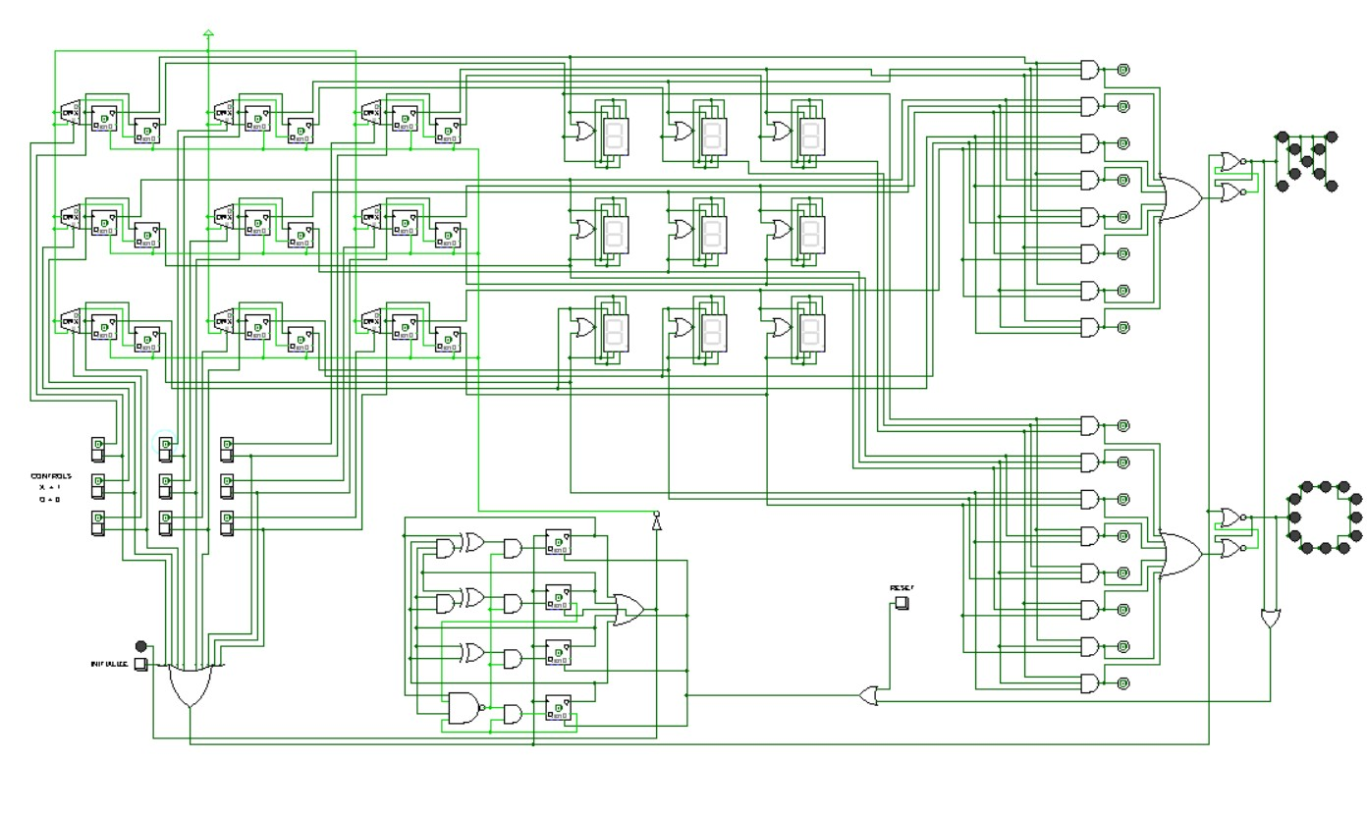
Circuit design:

Slide 7
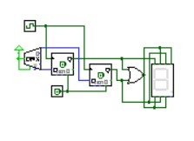
Move counter circuit:
This circuit ensures that the game proceeds turn-by-turn and automatically keeps track of moves, preventing errors and maintaining fairness between players.
Working principle:
The circuit uses D Flip-Flops and logic gates to create a simple counting mechanism.
Each time a player makes a move, a pulse signal (input trigger) is generated.
The counter increments the count by 1 on every pulse, representing one completed move.
A 7-segment display shows the current move number, helping players track progress.
The counter stops automatically once it reaches 9 moves (the total number of possible positions).
The output of the counter is also connected to the main circuit to ensure no extra moves are made once the grid is full.

Slide 8
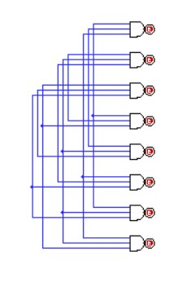
Winning combination detector circuit:
This circuit acts as the decision-making unit of the Tic Tac Toe game. It continuously checks player moves and instantly detects the winner, ensuring accurate and logical gameplay.
Working principle:
The detector uses AND gates to check all rows, columns, and diagonals of the 3×3 grid.
Each AND gate combination corresponds to one possible winning pattern.
When any three cells in a line (row, column, or diagonal) contain the same player input (either X=1 or O=0), that AND gate produces a HIGH output (1).
The output signal from the winning AND gate activates the LED display circuit, which lights up in the respective X or O pattern.
The circuit ensures only one player’s signal is accepted at a time, avoiding overlap or false wins.
Once a win is detected, the main game circuit stops further moves until reset.

Slide 9
Final circuit:
The final integrated circuit successfully simulates a digital Tic Tac Toe game using combinational and sequential logic in Logisim software.
Working principle:
All subcircuits are connected together to form the complete Tic Tac Toe system.
Player Inputs:
Player A (X = 1) and Player B (O = 0) make moves alternately.
The Move Counter keeps track of the number of turns played (up to 9).
The Winning Combination Detector continuously monitors all possible rows, columns, and diagonals.
When a winning pattern is detected:
If Player X wins, LEDs light up in an X-shaped pattern.
If Player O wins, LEDs light up in an O-shaped pattern.
A Reset switch allows restarting the game after a match is completed.

Slide 10
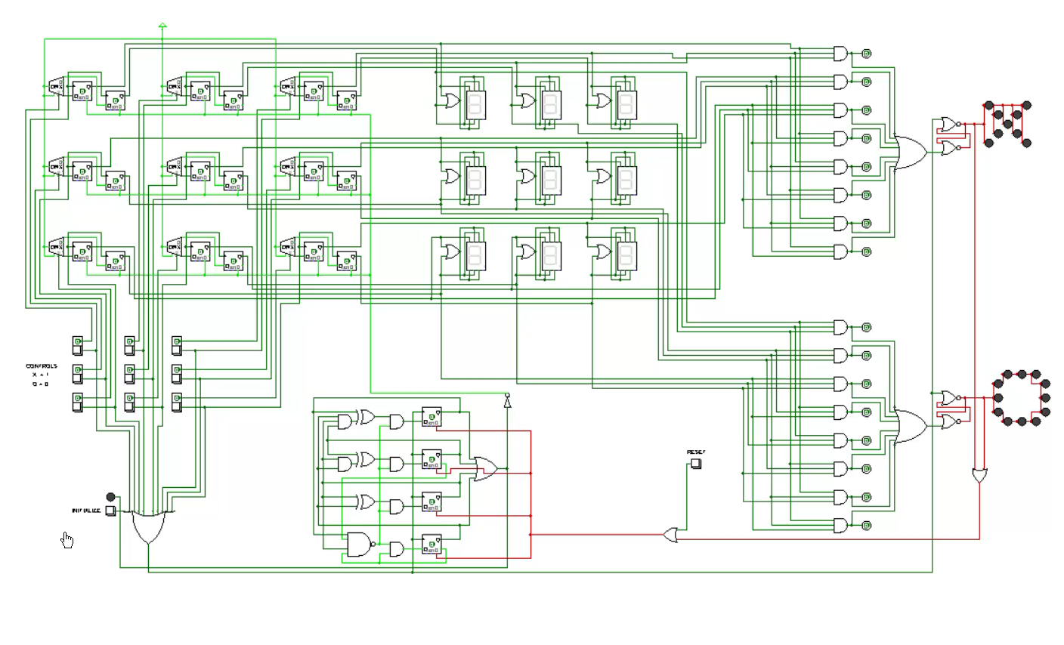
Results in different game scenarios:
Play video:-

Slide 11
Applications:
The core principles used in this Tic Tac Toe circuit are the foundation for many complex, real-world digital systems. This project demonstrates the practical application of these concepts –
State Machines: Our game is a simple "state machine." It uses D Flip-Flops to store the "state" of each cell (X, O, or empty). This same concept of storing a state is essential for:
CPU (Central Processing Unit) operations
Vending machines
Traffic light controllers
Input/Output (I/O) Control: The circuit processes player inputs from buttons and generates outputs on LEDs. This is the basis of all interactive digital systems, from calculators to complex computers.

Slide 12
Applications:
Combinational Logic (Decision-Making): The "Winning Combination Detector" uses logic gates (AND, OR) to instantly check all 8 winning conditions. This is how all digital decision-making works, including:
Arithmetic Logic Units (ALUs) in a computer.
Data routing and selection circuits (Multiplexers)Automated safety and alarm systems
Sequential Logic (Counting & Sequencing): The move counter circuit ensures that players take turns and that the game ends after 9 moves. This event-based counting is used in:
Digital clocks and timers
Program counters in a CPU (which track the next instruction)
Assembly line product counters

Slide 13
Conclusion:
In this project, we have successfully designed and simulated a complete Tic Tac Toe game circuit using Logisim software.
We successfully met all our key objectives:
A functional circuit was built that implements both move counting and an accurate winner detection system using digital logic.
The project serves as a practical, real-world model of how sequential circuits (like D Flip-Flops for storing moves) and combinational circuits (like logic gates for decision-making) are applied.
We demonstrated how fundamental components—logic gates, flip-flops, and counters—can be integrated to build a cohesive and interactive system from the ground up.

Slide 14
References:
Logisim Documentation – https://sourceforge.net/projects/circuit/
Mano, M. Morris. Digital Design, Pearson Education.
Floyd, Thomas L. Digital Fundamentals, Pearson.
TutorialsPoint – Digital Logic Design Basics.
Apna College – Digital Electronics using Logisim (YouTube Tutorials).

Slide 15


Slide 16


